Slide 1

Joe hall
Distributed denial of service

Slide 2
About me
10 Years with Thomson Reuters (Legal)
Projects Include
Electronic billing for law firms
Benchmarking attorney metrics – hours/fees/expenses
Analytics application development
Judges
Attorneys
Law Firms
Federal Courts

Slide 3
What is it?
A DDoS (Distributed Denial of Service) attack is an attempt to exhaust the resources available to a network, application or service so that genuine users cannot gain access.
A simple Denial of Service could be a technical accident where something (memory buffer overflows) force the shut down of the affected device; however, DDoS attacks are deliberate, malicious, and destructive.​

Slide 4
How does it work?
The target device has been deliberately overwhelmed with data packets.
Imagine five hundred people trying to run through a doorway at the same time.
The most common way that DDoS attacks are conducted these days is by leveraging control of a botnet

Slide 5
Different Types of DDoS Attacks?
Volumetric – attempt to saturate the bandwidth between the target and the Internet
TCP State-Exhaustion – consume the connection state tables within the infrastructure components
firewalls
web servers
Application Layer – target some aspect at Layer-7 of the OSI Model

Slide 6
Review of current data

Slide 7
Mitigation
Data processing services to analyze logs for attack patterns
Add Machine Learning to find correlations intelligently
Deploy rules to enhance filtering

Slide 8
My solution
Enhance log reading capabilities by introducing Apache Kafka into the logging process
Add a Spark cluster to analyze log streams and respond with the suspected IP address to take action

Slide 9
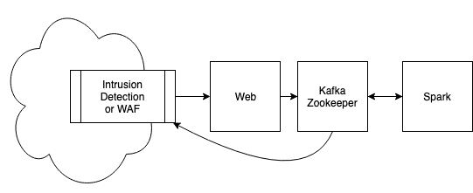
flow

